Slide 1
إدارة المشروعات الهندسية الفصل الخامس: هات 213 Engineering Project Management

Slide 2
What is Engineering Management?
Engineering Management is the management of activities and tasks needed to define and deliver specific products.
The goal is to deliver what the customer wants on-time and on-budget while meeting the required quality goals.

Slide 3
What is a Project Management?
A Project Is A Problem Scheduled For Solution.
A project is a temporary endeavour undertaken to create a unique product or service.
Project management is the application of knowledge, skills, tools and techniques to project activities to meet project requirements,

Slide 4
Why EM? (Objectives)
To teach students about the measurement of technical, business, and human performance processes required in engineering environments
To enhance the student's perspective on leadership and management of technology organizations;
To give students the knowledge and skills to manage projects and processes effectively;
To teach students to identify and balance the risks associated with technology development;
To broaden the engineering manager's perspective on the potential success or failure of an engineering project with respect to financing.

Slide 5
Your projects Cannot Afford to Fail !
66% of all IT projects fail, come in over budget or run past the original deadline
Every year, $55 billion is wasted on failed IT projects in the U.S.

Slide 6
Project Phases

Slide 7
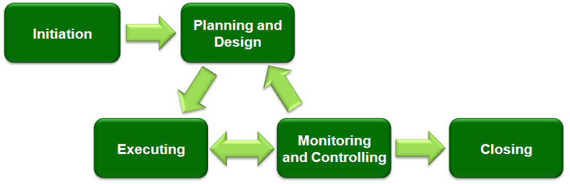

Slide 8
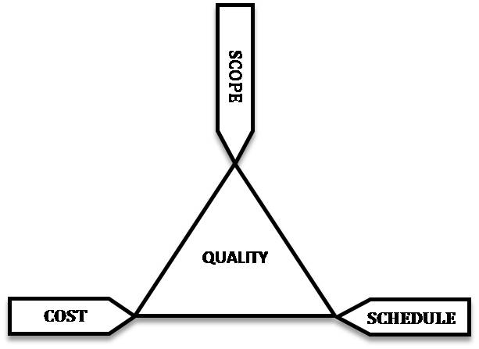
Project Management Triangle

Slide 9
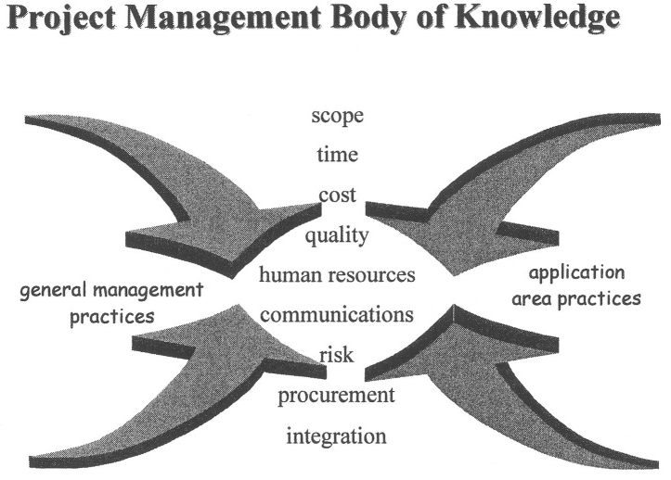

Slide 10
Who is a Project Manager?
Project Management is a skill as much as it is a profession.
Project Manager - responsible for managing project within constraints of:
Scope, Quality, Time & Cost
To deliver specified requirement & meet or exceed Customer Satisfaction.
Notes:
Accidental Profession – I did not graduate from High School and College and say to myself I want to be a project Manager!
Never a PM booth at any career fairs at the Universities or Colleges.
PM’s usually come up from the ranks of IT such as developers or systems analysts. You work on a project team and gradually move up the food chain until you lead certain parts of projects.
project Managers job is to:
define the tasks that are required on the project,
assemble the project team,
assign the resources to the project tasks,
monitor progress and crack the whip if necessary!
resolve issues as they arise
and above all COMMUNICATE!

Slide 11
Functional Mgr Vs. Project Manager
PM vs functional Mgr (FM, marketing, engineering, or finance)
FM -administratively responsible for deciding:
How Something done,
Who will do it,
What Resource to accomplish Task.
PM general starts career as a specialist
PM, to oversee many functional areas.

Slide 12
Project management. Organization showing typical
responsibilities of a project Manager
project
Manager
Finance
Engineering
Contracts
Planning
Manufacturing
Procurement
Quality

Slide 13
Qualities of Project Manager
Can Work with large no. of groups & understands their demands & concerns
“Control & Evaluate project Performance”
Build Spirit of Cooperation
Relate, compare, classify, & evaluate facts
Distinguish Essential vs Non-essential

Slide 14
Selecting Project Manager
Selection of PM -most important decisions.
Most popular attributes, skills, & qualities for Project Manager:
Strong technical background
Hard-nosed manager
Mature individual understand culture
Good terms with senior executives
Can keep project team happy
One who has worked in several different departments
Person who can walk on (or part) waters

Slide 15
Characteristics for Project Manager
Flexibility & Adaptability
Significant initiative & Leadership
Aggressiveness, confidence, persuasiveness, verbal fluency
Ambition, activity, forcefulness
Effectiveness as a communicator & integrator
Broad scope of personal interests
Poise, enthusiasm, imagination
Balance technological solutions with:
Time, Cost, & H- factors

Slide 16
Time, Cost, & H- factors
Balance in “Use of Time”
Well Organization & disciplined
Generalist not a specialist
Devote most of his time-”Planning & Controlling”
Other factors
Identify Problems
Willing to make decisions
Personal attributes- either attract or deter highly desirable individuals.
Project Manager Must like trouble.
Capable of evaluating risk & uncertainty.

Slide 17
Basic characteristics:
Honesty & integrity
Personnel problems
Know project technology
Business Mgt Competence
Mgt principles
Communication
Alertness Quickness
Versatility
Energy, Toughness
Decision-Making Ability

